Slide 1
Ridesharing in Social Network
Andrea 李照

Slide 2
Previous Work
Clarify the problem definition and optimization goal.
Acquire dataset from open source database.
Realize simulation system under social network.
Get the first step result from simulation.

Slide 3
Previous Question
Why the match rate is higher than before?
- The Ridesharing algorithm is highly connected with physical location. The social network forces the algorithm to find customers who share source position or destination and thus becomes an optimizer.

Slide 4
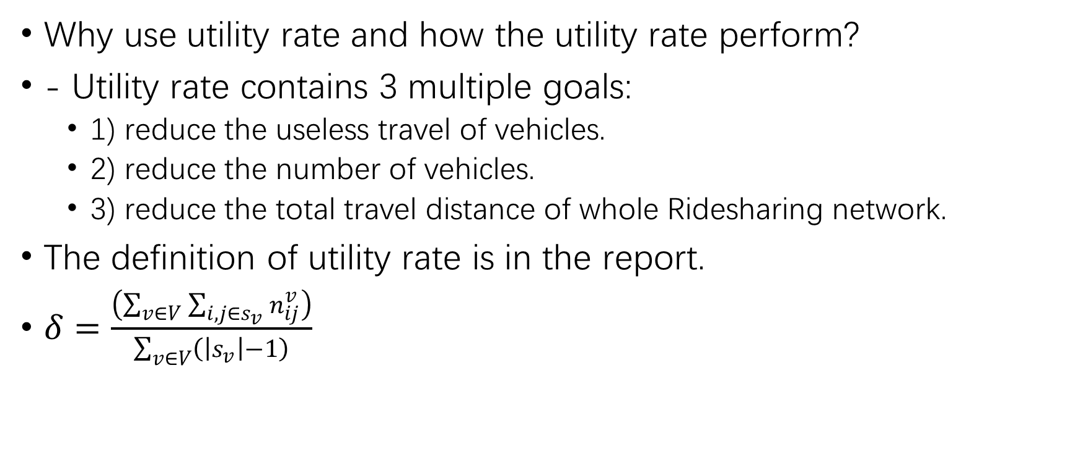
Previous Question
Why use utility rate and how the utility rate perform?
- Utility rate contains 3 multiple goals:
1) reduce the useless travel of vehicles.
2) reduce the number of vehicles.
3) reduce the total travel distance of whole Ridesharing network.
The definition of utility rate is in the report.
$δ=\frac{\left(\sum_{v∈V}{\sum_{i,j∈s_{v}}{n_{ij}^{v}}}\right)}{\sum_{v∈V}{\left(\left|s_{v}\right|−1\right)}}$

Slide 5
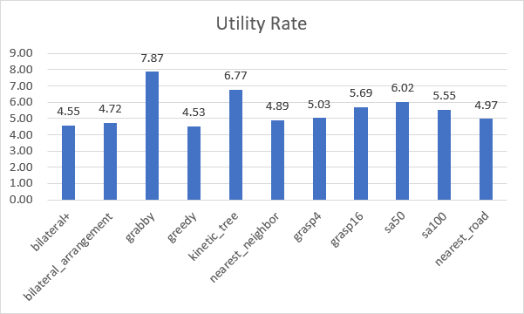
Utility Rate of Each Algorithms

Slide 6
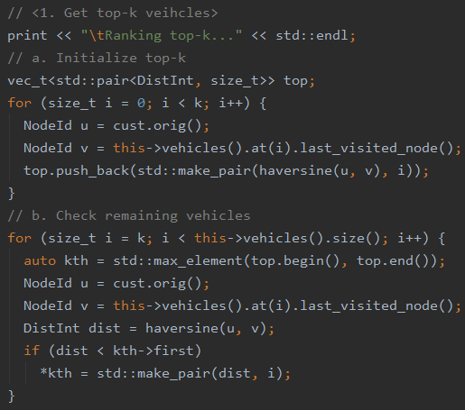
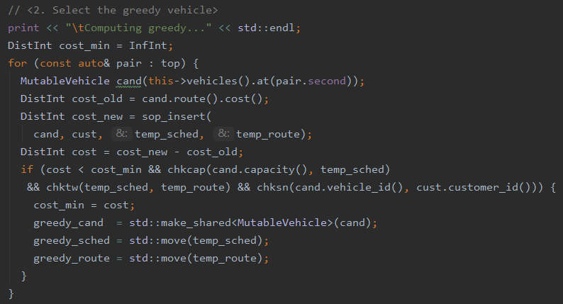
Top-k Algorithm (k=10)
An outstanding algorithm to maximum the utility rate.

Slide 7
Difficulties and Future Work
There is NO dataset contains both social network and traffic information.
There is NO research on physical location relationship along with the social network.
The previous 2 difficulties need to be solved.

